Slide 1
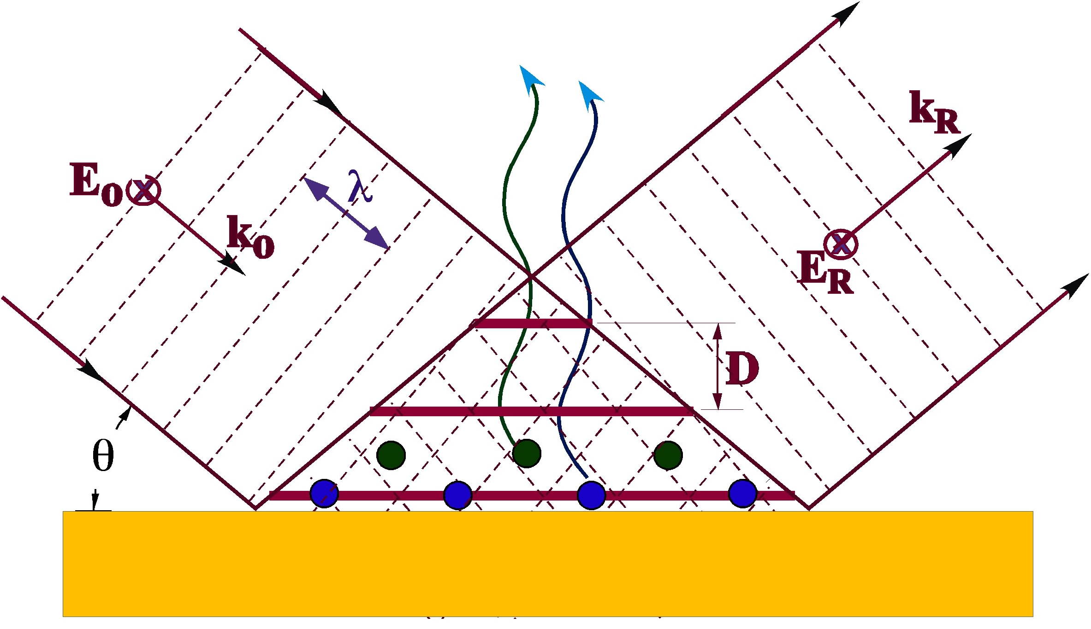
X-Ray Interface Science
Michael Bedzyk
Materials Research Science and Engineering Center (MRSEC)
Institute for Catalysis in Energy Processes (ICEP)
International Institute for Nanotechnology (IIN)
Center for Electrical Energy Storage (CEES)
Synchrotron Research Center (SRC)
X-rays: APS, NU X-ray Lab, ESRF
Funding: NSF, DoE, Airforce

Slide 2
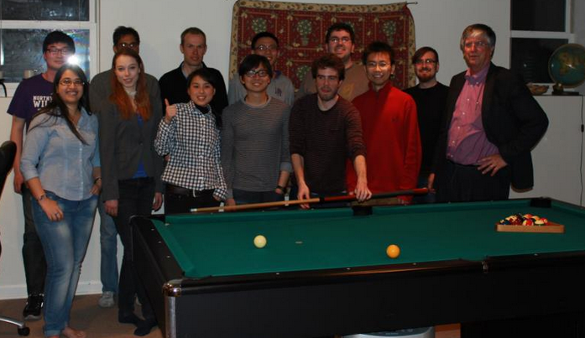
Group Party June 2013
Group breakdown: 2 postdocs, 7 graduate students

Slide 3
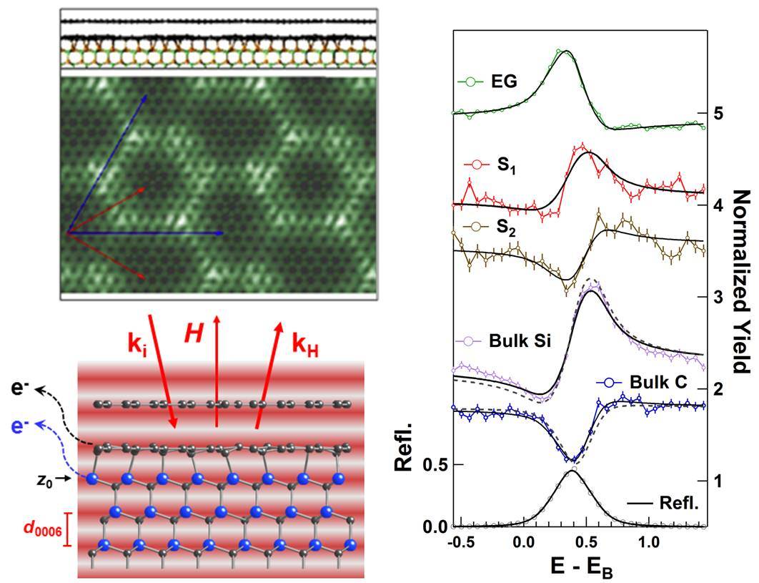
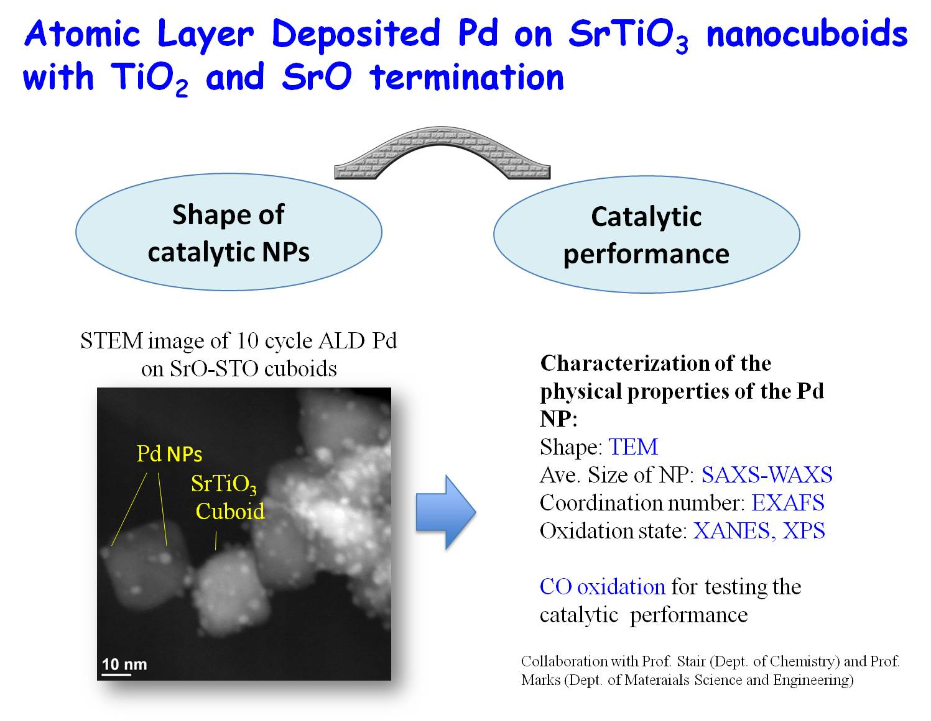
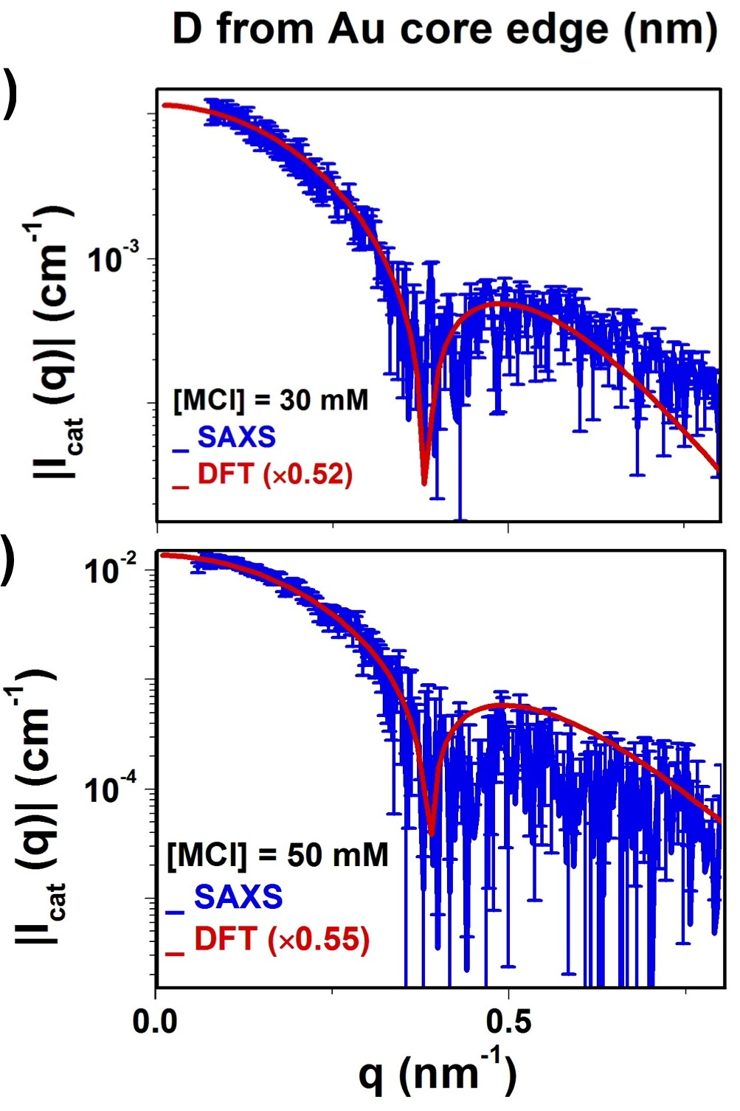
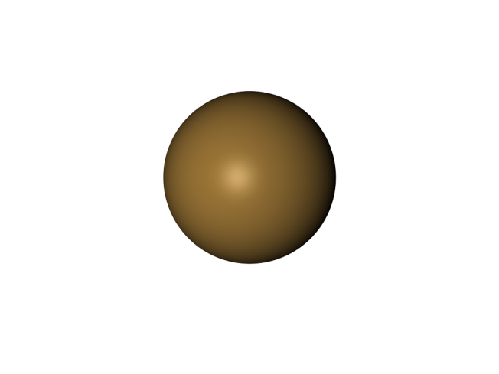
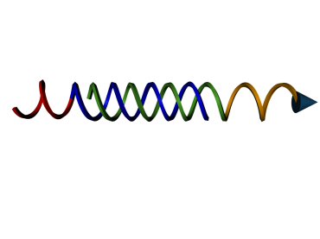
Bedzyk Group Overview: Atomic Scale View of Interfacial and Nanoscale Processes with X-Rays
Nanoscale Electrodes for Li-Ion Batteries
X-ray Standing Wave studies of graphene
X-ray Scattering and Absorption Studies of Au Nanostructures for DNA Functionalization and Assembly
Ion distribution around DNA-NPs
DNA-NP Schematic
A10
Au
18bp duplex
C3-SH
Nanorod growth and functionalization

Slide 4
Some X-ray Basics: Wave Property ➔Structural Info λ = 0.1 to 10 Å wavelength E-M radiation X-rays scatter coherently from electrons Particle Property ➔Compositional Info E_{ϒ} = 1 to 100 keV energy Photo effect: Inner shell (K, L) ionization XRF : Decay of excited ion to ground state by characteristic XRF emission

Slide 5
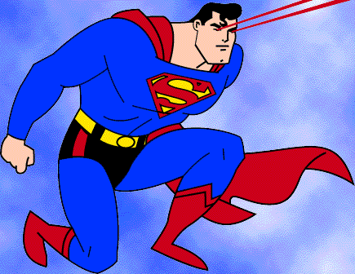
X-ray Vision
Advantage:
Weak interaction with matter
High penetrating power
→In situ analysis
→ Buried structures
Atomic-scale resolution
Problem:
Weak interaction with matter
→ weak signal
Need very intense X-ray source

Slide 6
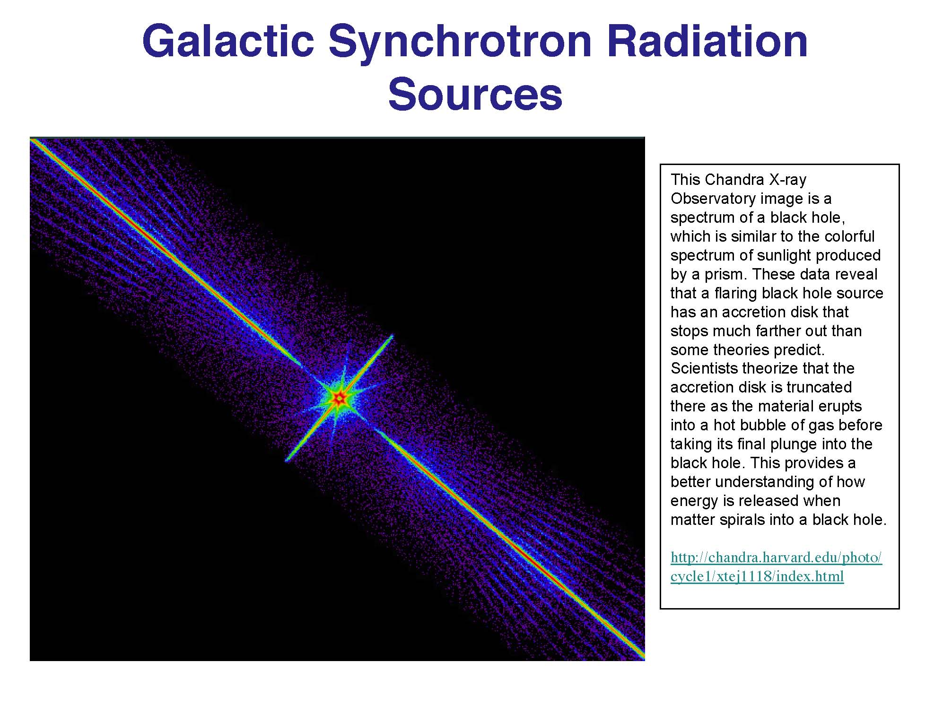

Slide 7
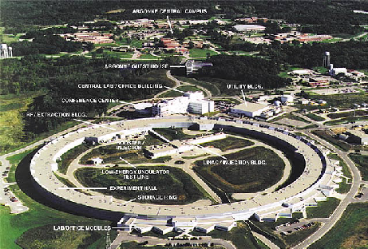
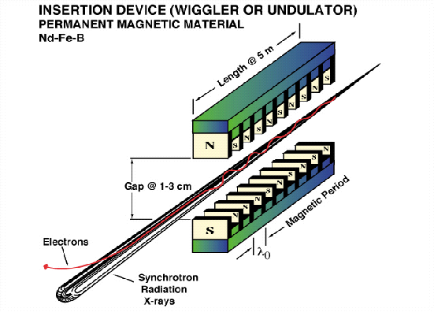
Brightest X-ray Source in Western Hemisphere
= Advanced Photon Source
Undulator Device
relativistic electrons pass thru periodic magnetic array

Slide 8
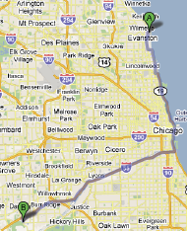
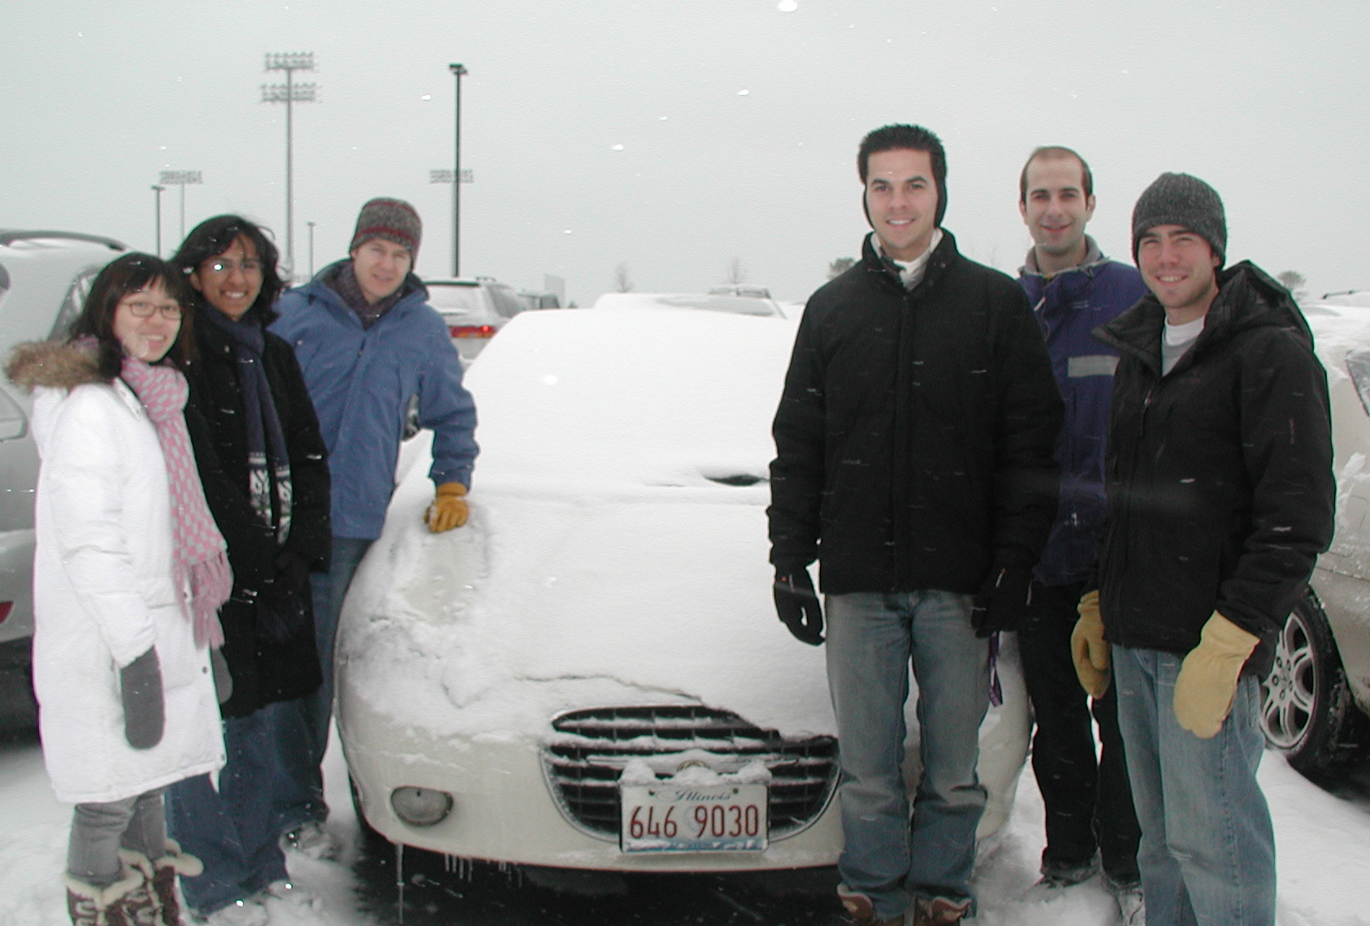
Argonne National Laboratory
Funded by US Dept. of Energy Lab
NU
NU-ANL Carpool
ORD
ANL

Slide 9
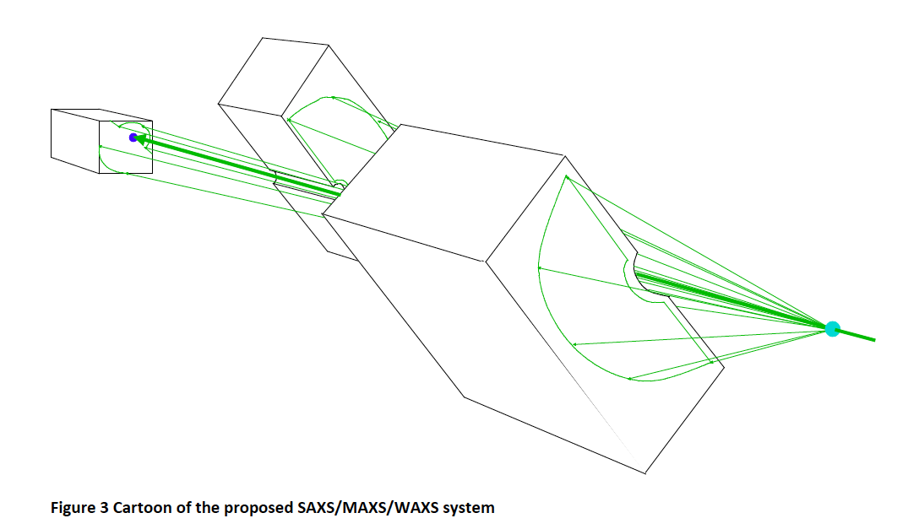
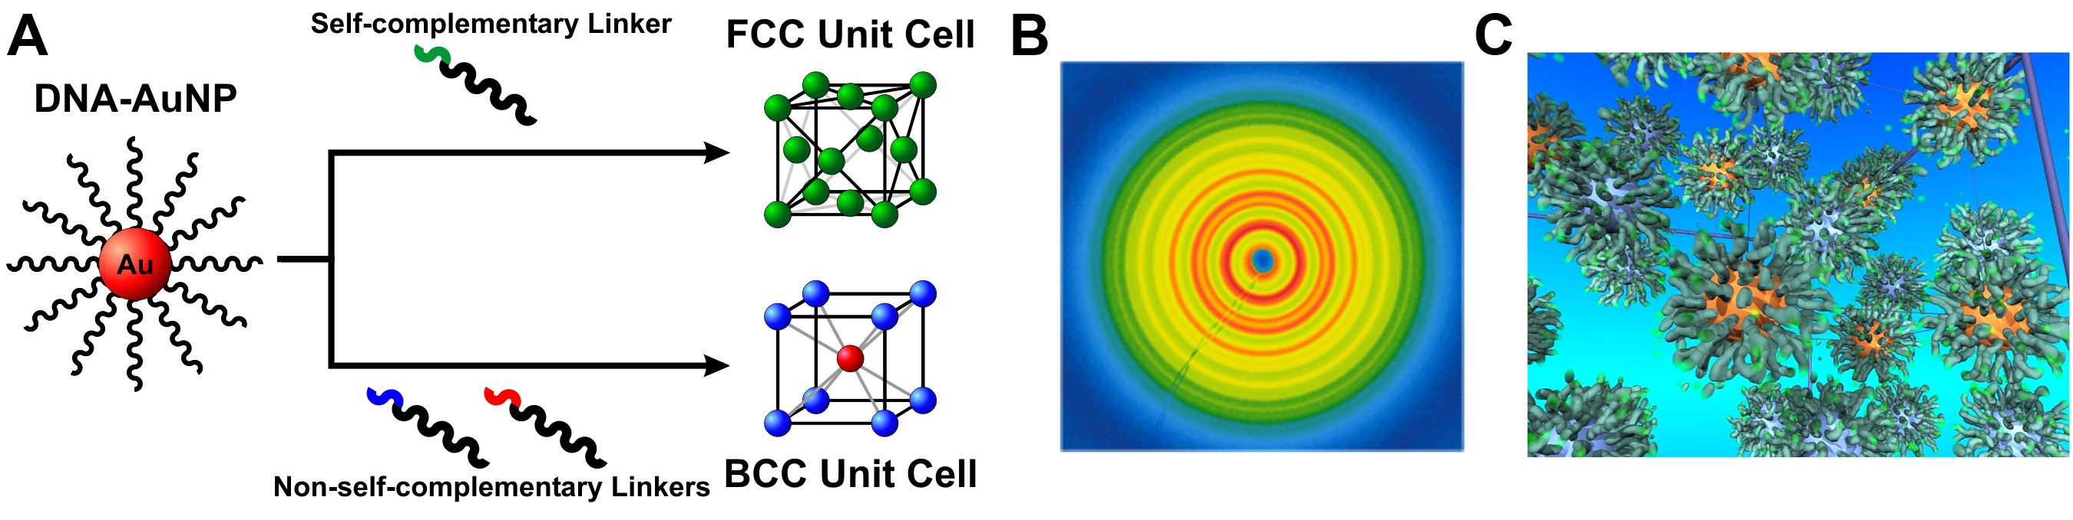
Simultaneous SAXS-MAXS-WAXS at DND-CAT/APS
3 CCD Areal Detectors
MAXS
Capillary Tube
with flowing
Sample Solution
SAXS
WAXS
Incident
X-ray Beam
$1.2 M, Just completed Upgrade

Slide 10
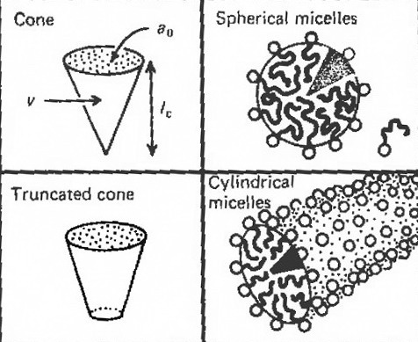
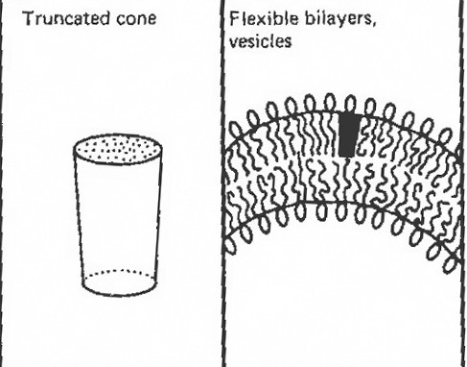
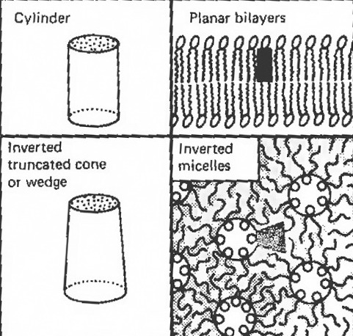
Self-assembled systems of amphiphiles
A
Spherical
micelle
Critical packing parameter
= V/AL
V
L
Fiber
hydrophilic
hydrophobic
Curved
membrane
Planar membrane
Notes:
Chemistry Aspect of research

Slide 11
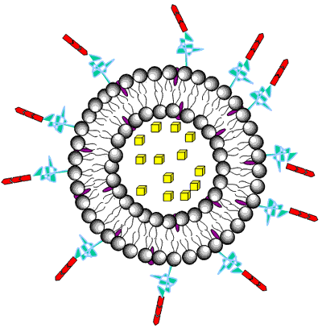
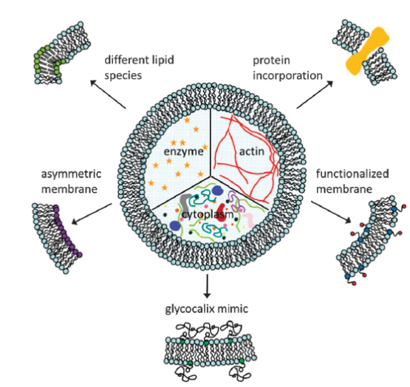
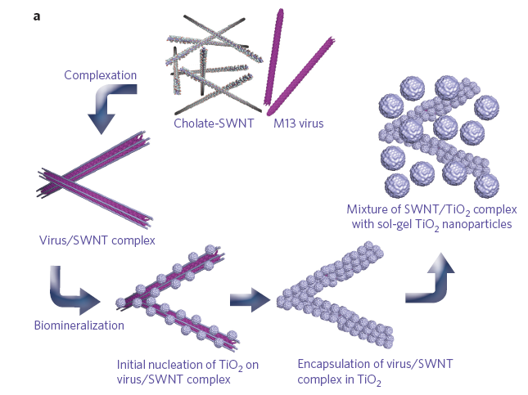
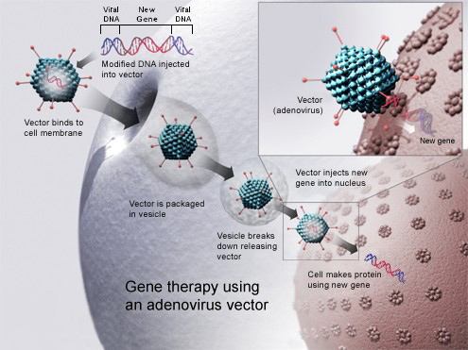
Applications
Drug delivery
Cell model
Photovoltaic cells
Gene therapy
Template for synthesis, tissue regeneration…..

Slide 12
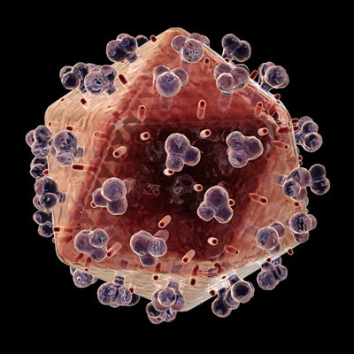
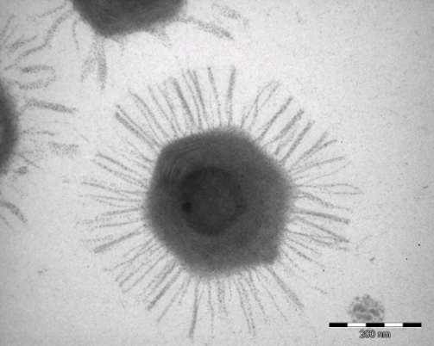
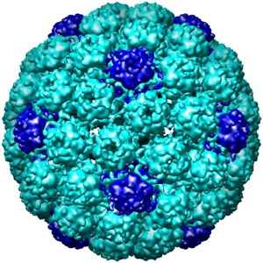
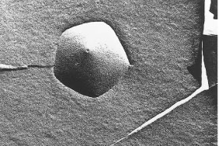
Shells of different shapes
HIV virus
(~150 nm across)
Mimvirus
(~200 nm across)
Mouse Polyoma Virus
(~50 nm)
icosahedral
spherical
Crystalline lipid vesicle
(~1 μm across)
(Dubois, et al., Nature 2001)
Notes:
Homogeneous, each face is equivalent to other. Principle of Caspir and Klug(each of the 20 facetted faces are all equivanent)

Slide 13
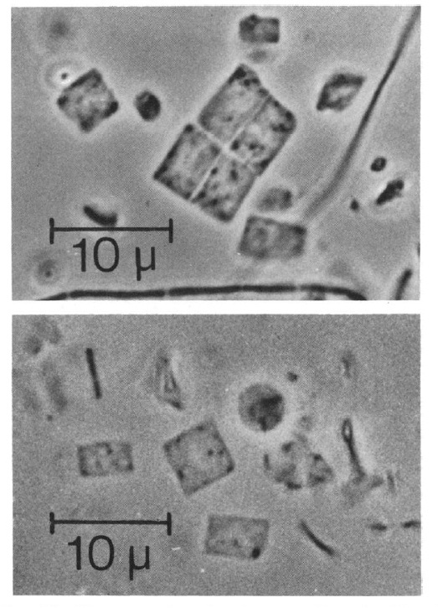
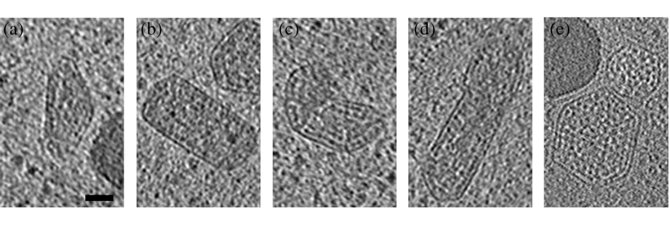
100 nm
-size and shape variability of cellular carboxysomes
(Iancu, et al., J. Mol. Biol. (2010) 396, 105–117)
-Walby’s archaea organism
-hexagonal lattice
(W. Stoeckenius J. BACTERIOLOGY, (1981))
- Mixed component system
Notes:
1) Low symmetry , square but with hex , driven by electrostatic (divalent ion)
PS. Sphere to cube if it is rect ( they are in Mg, electrostatic driven), turn to sphere if dragged out
(Sphere to icosa if it is hex)
Boundary has some weak Young Modulus , kind of

Slide 14
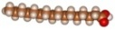
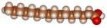
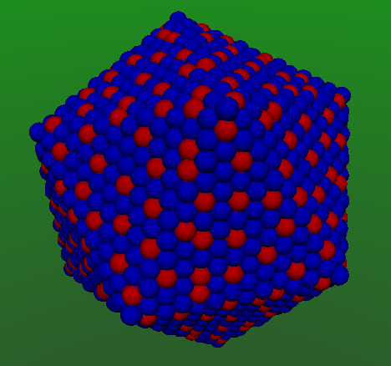
Catanionic self-assembled membranes
cation
anion
+
-
+
cones
cylinders
- Crystalline membranes (with internal order):
Young’s modulus > 0
- Fluid Membranes (no internal order):
Young’s modulus (Y) = 0
Bending rigidity (κ)
Notes:
14
Vesicles are small tenuous objects easily prepared by mixing small amounts of surfactant molecules like phospholipids with pure water. Observed with a phase contrast microscope, they most of the time look like slightly fluctuating deformed spherical bags, with their size ranging from 1 to 100 micrometers.
Their membrane is made of a bilayer of the surfactant molecules. These are asymmetric molecules, with one polar (hydrophilic) head, and one or more hydrophobic tails, the tails gathering together inside the bilayer, protected from the water by a « sandwich » made by the heads. This very thin membrane (around 5 nanometers) is fluid, meaning that all the molecules are free to wander along the membrane, thus allowing shear of the membrane at no cost. Its similarity to cellular membrane freed of its embedded proteins, makes vesicles simple models for the study of some of the physico-chemical properties of cell as well as of their shapes.
The physics of fluid membranes was first developed in order to study emulsions and micro-emulsions, binary or more complicated mixtures which are used in almost all fields of human activity, from cooking, painting, etc, to oil extraction. Vesicles, which form a subclass of the spontaneously organized phases of these mixtures, are also used in cosmetics, in drug delivery, etc, in addition to them being a simple model of the cellular membrane.
It turns out that the first non negligible energetic term which enters the physical description of vesicles, is a curvature term. As stated above, shear stresses lead to no energetical cost, due to the fluidity of the membrane, and vesicles being closed and freely suspended in solution, the residual internal tension has negligible effects, when the deformations of the membrane remain small, which is almost always the case.
The resulting elastic energy, first studied by Canham, Evans and Helfrich, reads as a surface integral on the membrane [1-3]:
(1)
where k is the bending elastic modulus, usually of the order of some tens of kBT for phospholipid bilayers (k ~ 10-12 erg), and H = 1/2 (C1 + C2) is the local mean curvature of the surface S. A term taking into account the gaussian curvature G = C1C2 is usually omitted, being constant for all shapes within the same topological class.
An obvious property of (1) is its scale invariance, which states that two vesicles which differ only by their size, not by their shape, have the same elastic energy. As a consequence, it is not the real value of the volume V and the area A of a vesicle which are important, but there adimensional ratio, called the reduced volume:
(2)
Vesicles are characterized by a remarkable stability: their volume and area remain stable during days. As a result, to study their equilibrium shapes means to minimize (1) given the reduced volume constraint (2).
The first calculation done using this scheme aimed to find a purely physical basis to the red blood cell discoid shape. In fact, the red blood cell shape can be obtained, but only by taking into account the asymmetry of the bilayer membrane: due to the curvature, there are less molecules on the inner side of the bilayer than on its outer side. This number difference being conserved on relatively long time scale, it can be taken into account introducing a new geometrical parameter, the area difference, which again because of the scale invariance of (1), can be replaced by a dimensionless parameter, the reduced area difference:
(3)
Using these two geometrical parameters as physical constraints set up at the time of vesicular equilibration, one obtains a wide variety of vesicle shapes, among which those of the red blood cells [4].
Another interesting shape observed upon a temperature variation is that of a budding daughter vesicle linked to a bigger one by an infinitesimal neck, as seen during exocytosis [5]. This morphological change can be described in the framework described previously by supplementing a simple law for the area dilation with temperature [6,7].
Finally, let us state that this model allows a direct measurement of the bending modulus k from the thermal fluctuations of the vesicular shape [8].

Slide 15
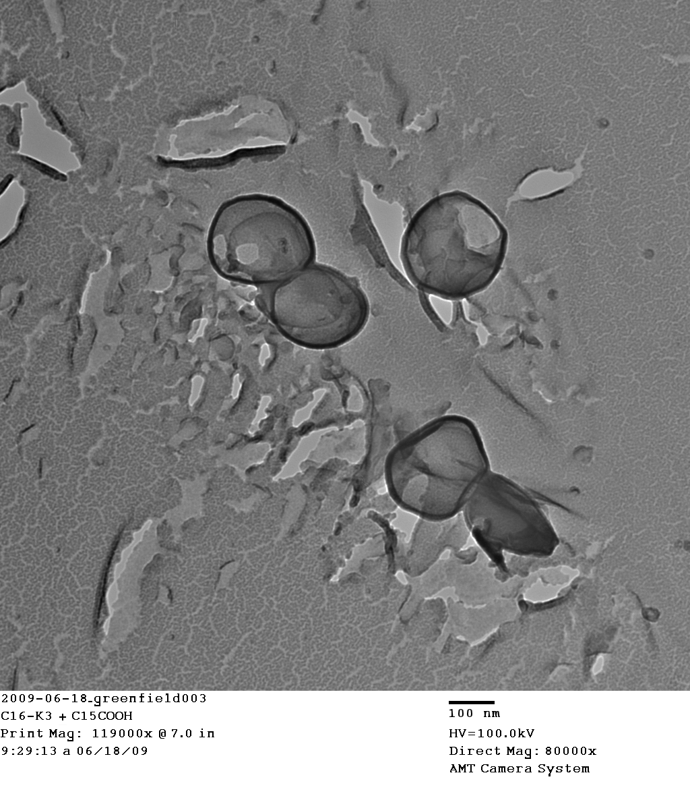
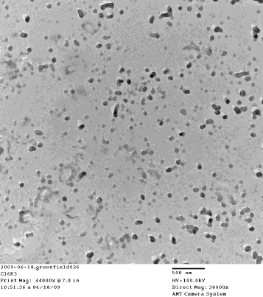
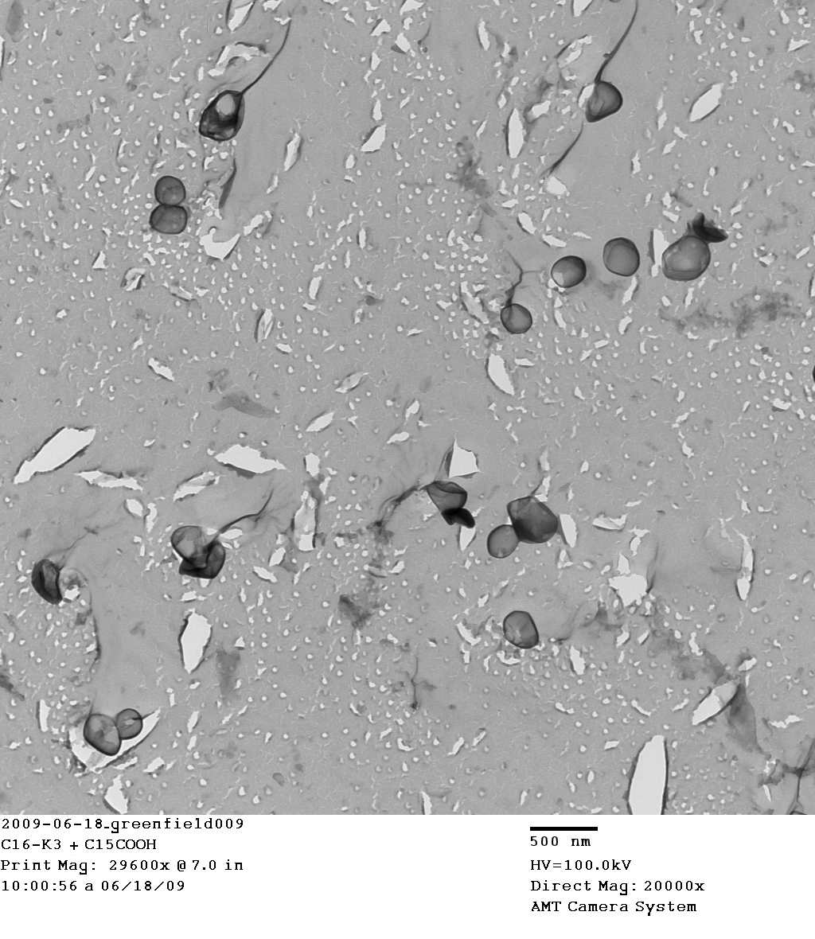
Quick-freeze deep-etch TEM microscopy
images
Cation alone
Cation + anion mixture
100nm
500 nm
500 nm
Notes:
Quick-freeze deep-etch TEM microscopy

Slide 16
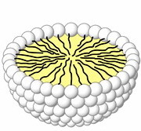
Small/ Wide Angle X-ray Scattering (SAXS/ WAXS)
X-ray
2θ
Fourier Transform
I
SAXS - 1-100 nm scale features
- size and shape
WAXS - molecular packing
- crystal structure
q (nm⁻¹)

Slide 17
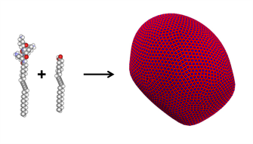
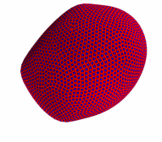
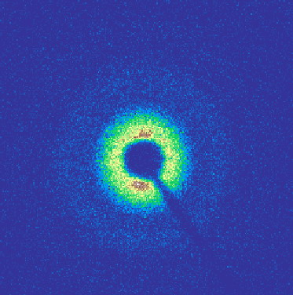
SAXS/WAXS Data Processing
X-Ray
Vesicles or membranes flowing freely in solution
1D graph of intensity vs q
Do an angle averaged integration
q (Å⁻¹)
2D images from SAXS

Slide 18
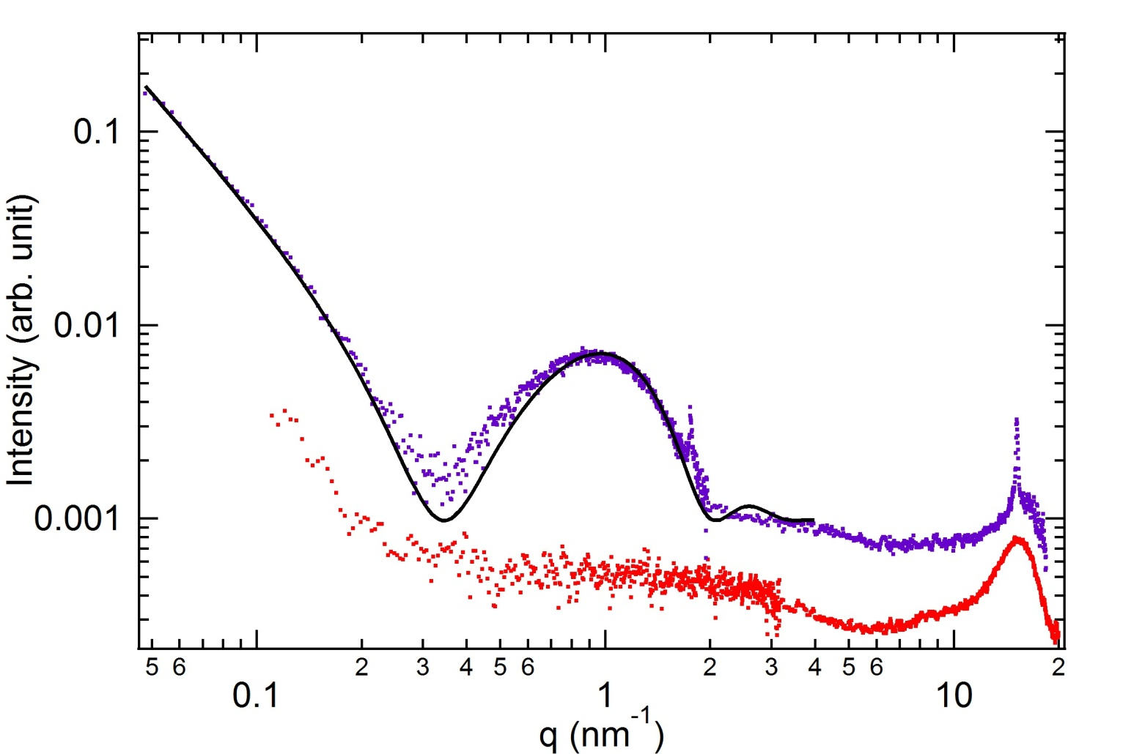
Model fit of bilayer structure
+3 Cation and -1 anion mixture vesicles
Porod Power Law
α = 2 ➔2D platelet
cation
Cation only
3.8 nm
2.1 nm
5.3 nm
Fit the data with a bilayer model to obtain thickness

Slide 19
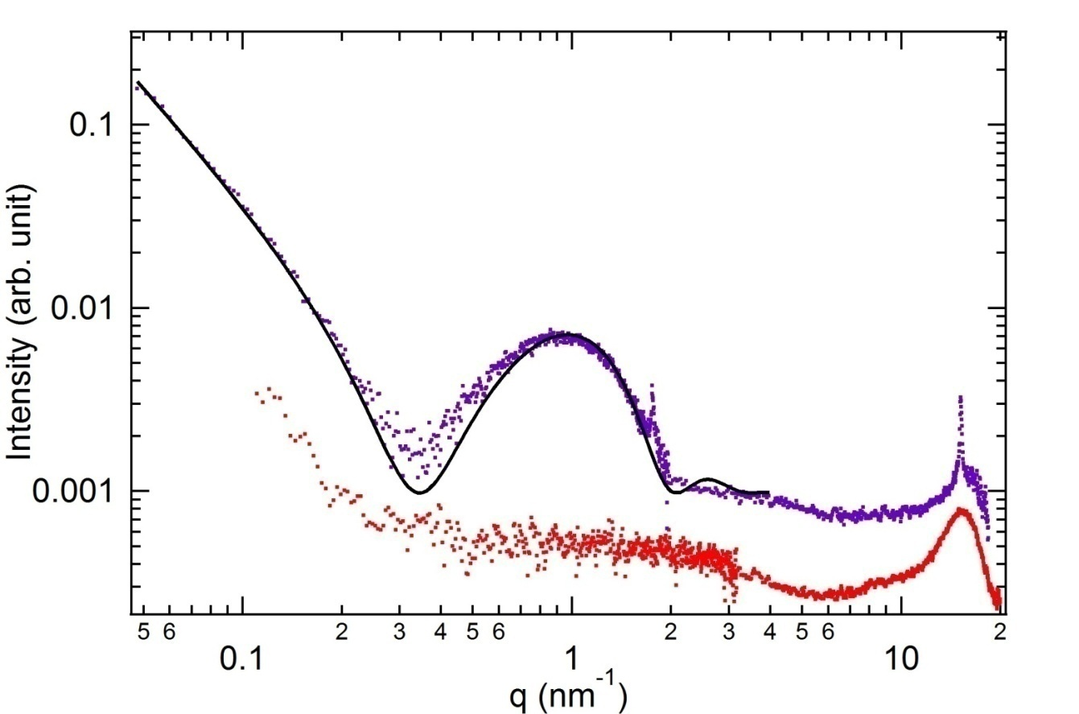
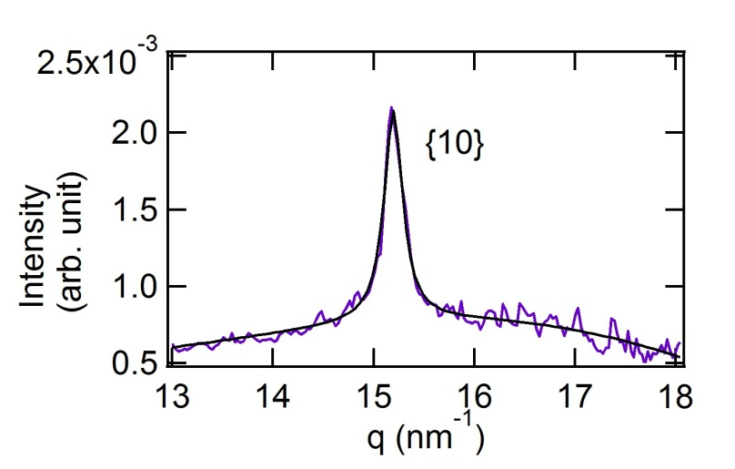
Molecular packing within membrane
+3 Cation and -1 anion mixture vesicles
Cation alone
α = 2
WAXS
d = 2π/q = λ/2sinθ
= 0.413 nm
Hexagonal lattice
Electrostatic attraction induces crystallization of tails
Area/ molecule
= 0.197 nm²
Packing of tails
0.477 nm
Notes:
Tail disordered

Slide 20
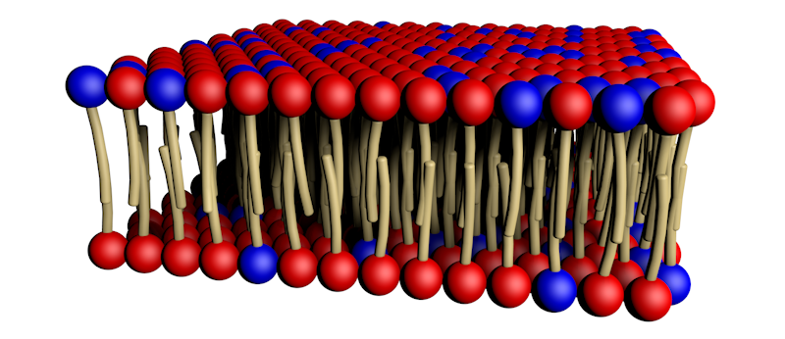
Why do we want to control membrane crystal structures?
- Crystal structure can change morphology
- Molecule flow rate across membrane can be controlled by packing density and membrane thickness
- Hydrophobic drugs encapsulated inside membrane

Slide 21
Questions
Can we control the crystal structure?
Can we control the shape of the vesicles or membrane morphology?
Play with electrostatics!
Change pH to change effective charge of head groups.
Change tail length to change dipolar van der Waals attraction

Slide 22
What a new student in the Bedzyk group might expect to be involved with while pursuing their PhD
Gain an expertise with general x-ray techniques and experimental design
Learn fundamental materials science/ chemistry/ physics/ biology relevant to the systems they are studying (interdisciplinary research)
Take measurements at the Advanced Photon Source and help develop the Dupont-Northwestern-Dow beamline (sector 5)
Understand atomic-scale structure and how it applies to desirable materials properties

